Slide 1



Monday
Coffee
Analysis with Sql

Slide 2
WELCOME
The goal of this project is to analyze the sales data of Monday Coffee, a company that has been selling its products online since January 2023, and to recommend the top three major cities in India for opening new coffee shop locations based on consumer demand and sales performance.

Slide 3
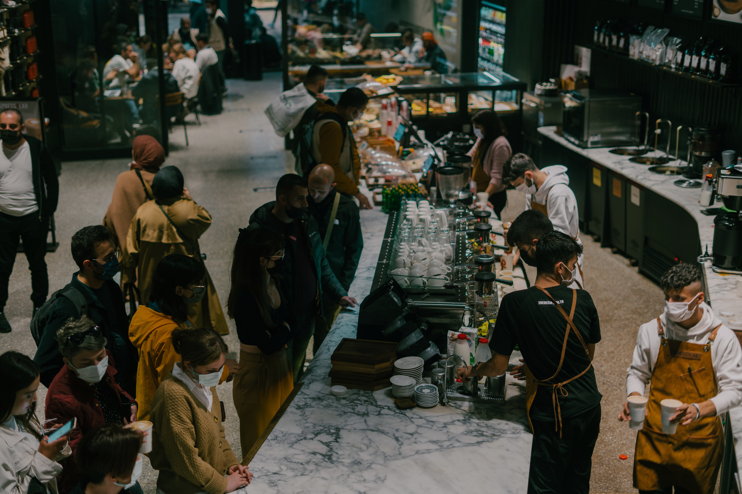
Time to Analysis

Slide 4
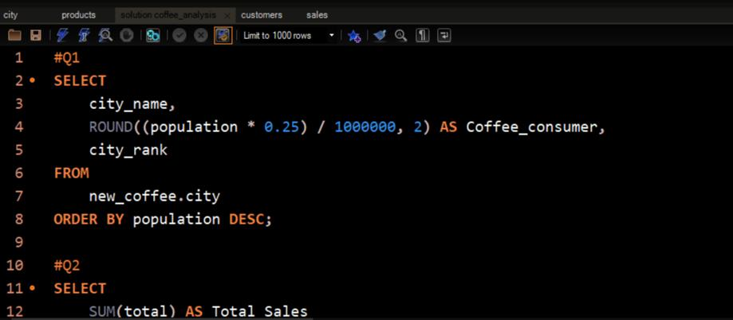
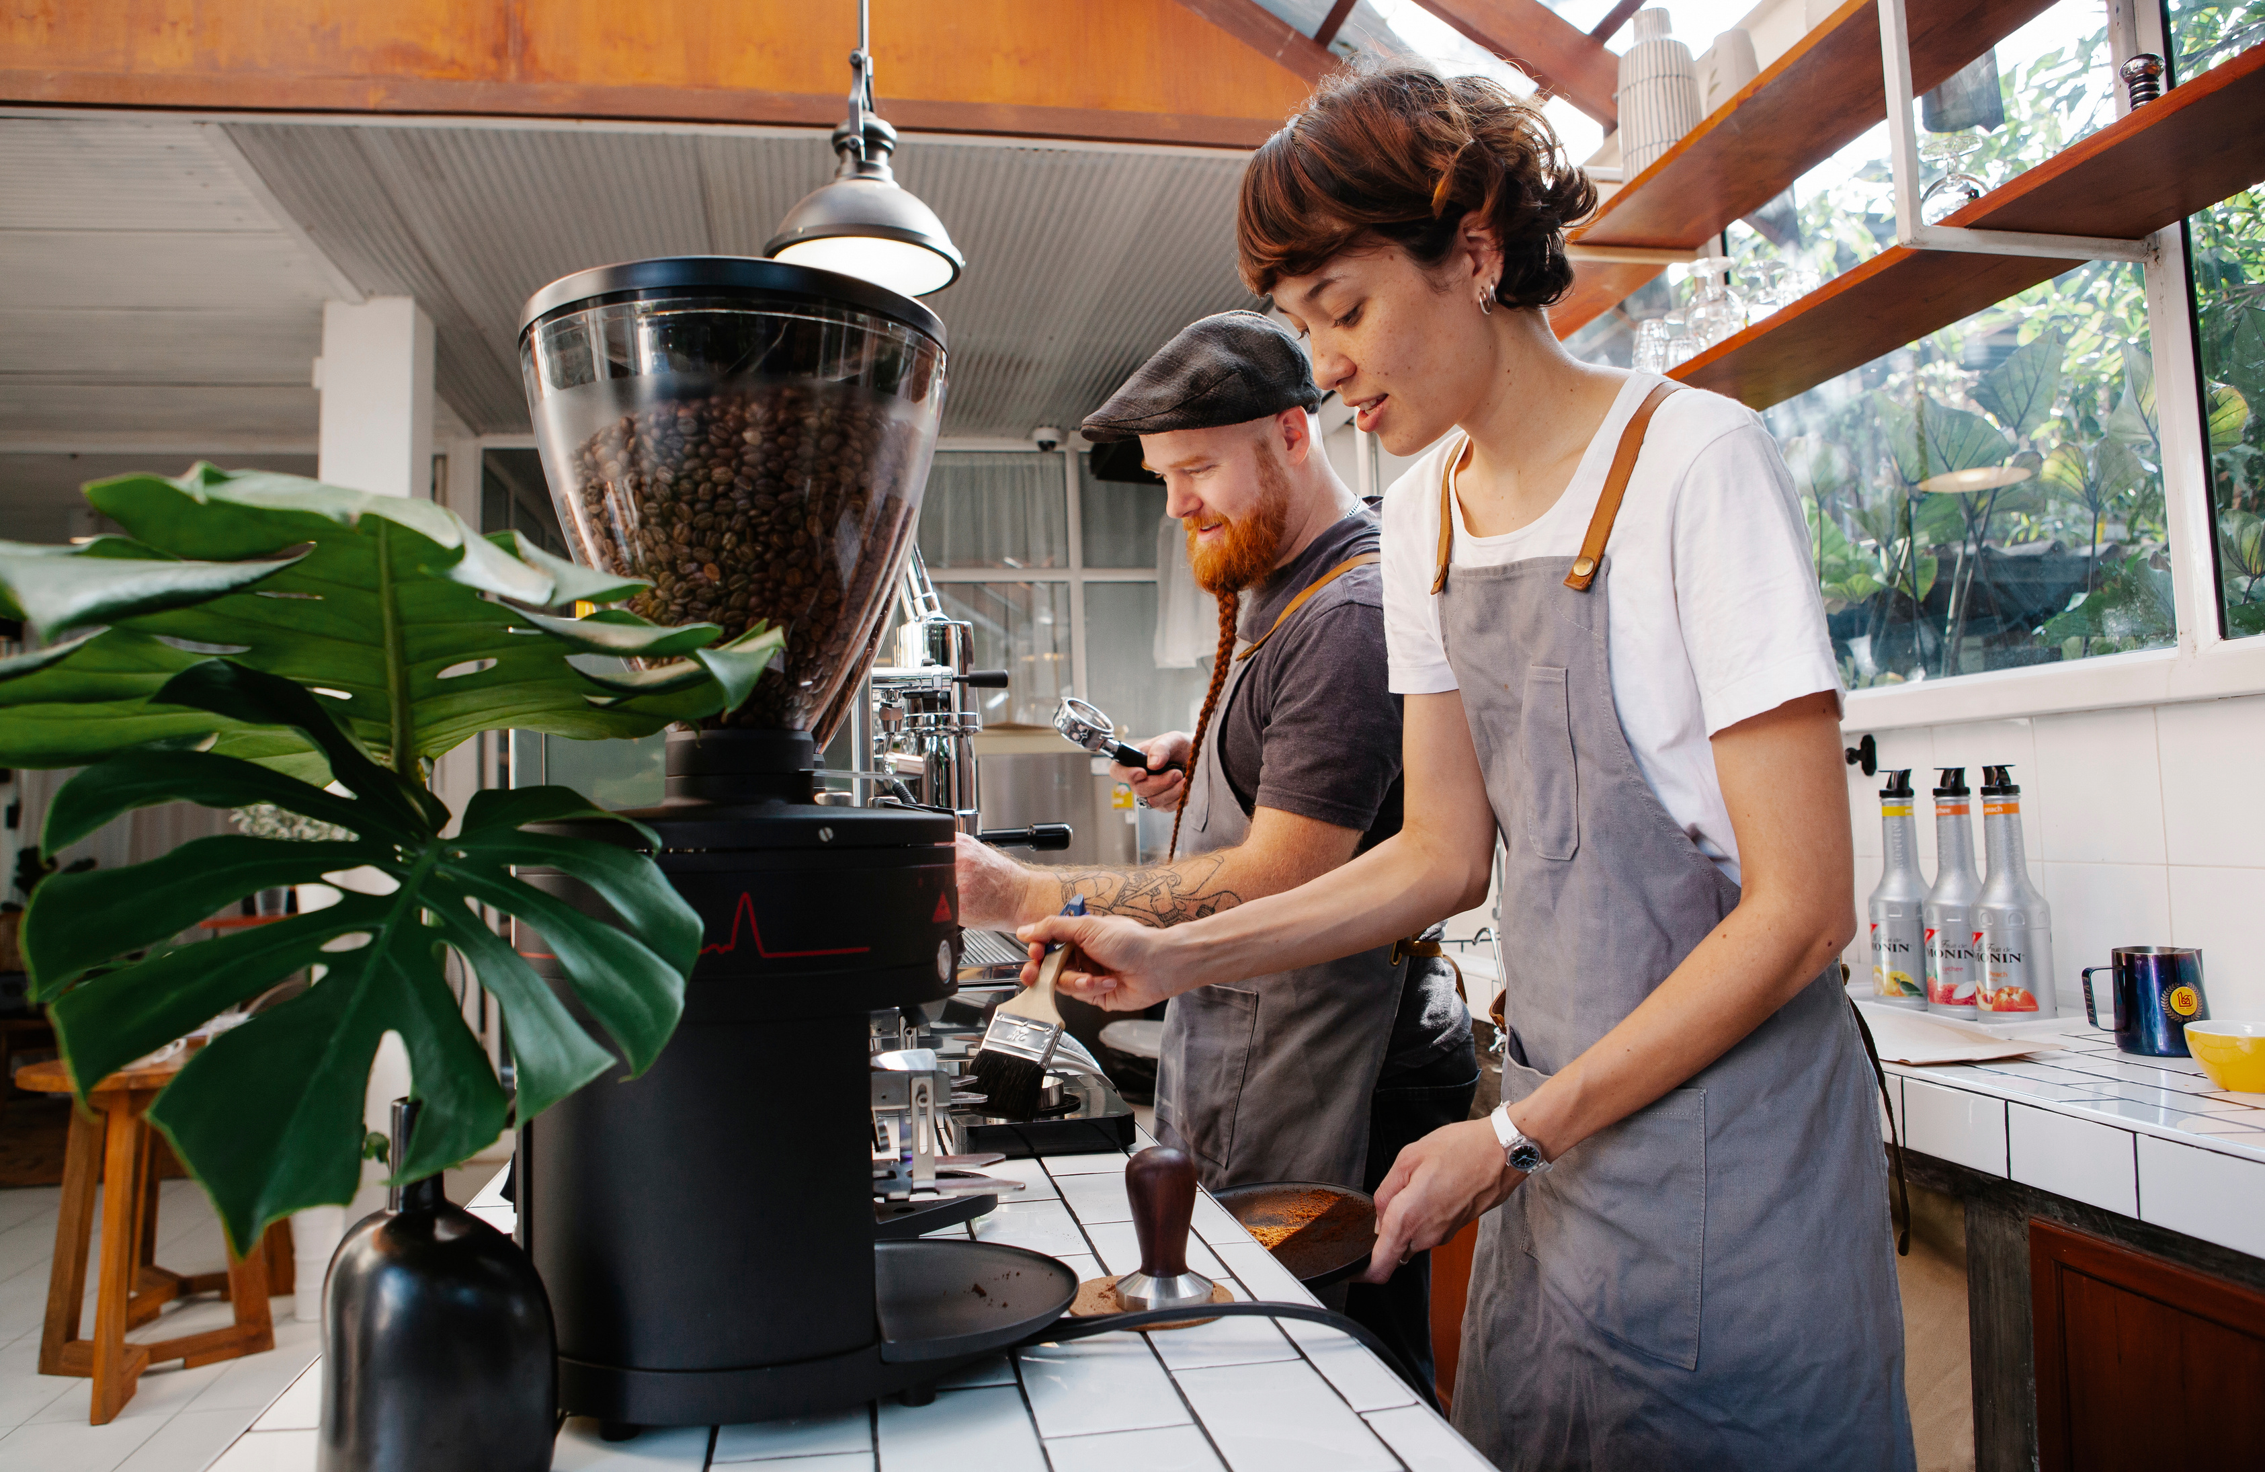
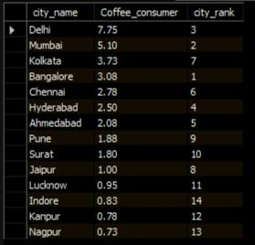
1. Coffee Consumers Count
How many people in each city are estimated to consume coffee, given that 25% of the population does?

Slide 5
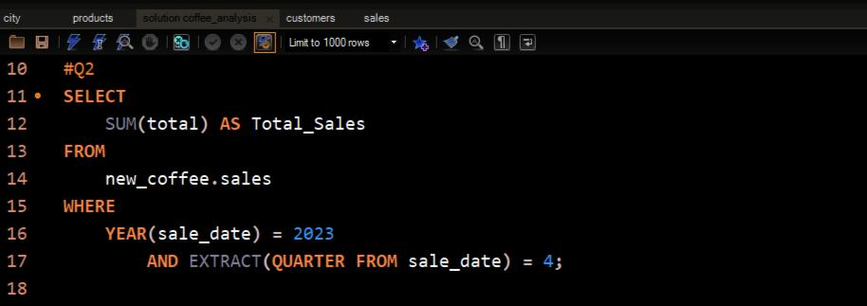

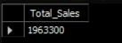
2. Total Revenue from Coffee Sales
What is the total revenue generated from coffee sales across all cities in the last quarter of 2023 ?

Slide 6
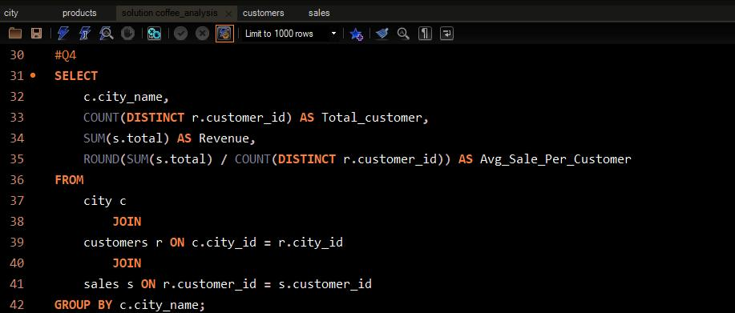

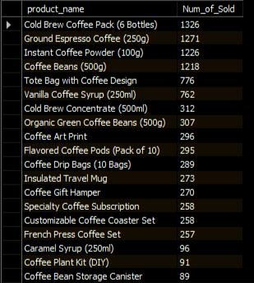
3. Sales Count for Each Product
How many units of each coffee product have been sold?

Slide 7

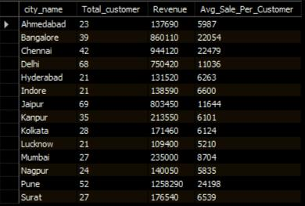
4. Average Sales Amount per City
What is the average sales amount per customer in each city?

Slide 8
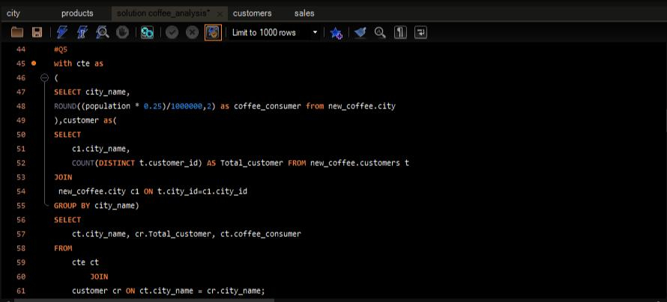

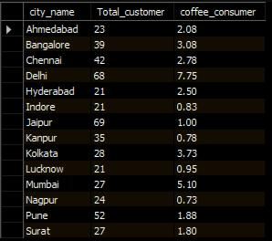
5.City Population and Coffee Consumers
Provide a list of cities along with their populations and estimated coffee consumers?

Slide 9
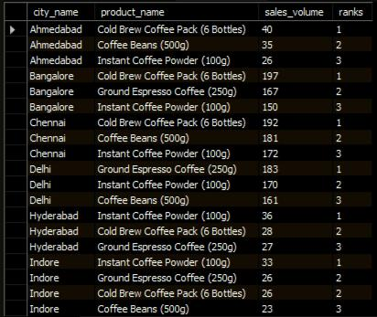
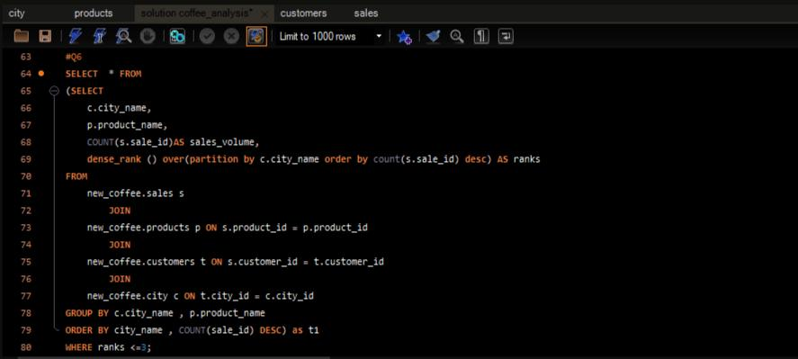
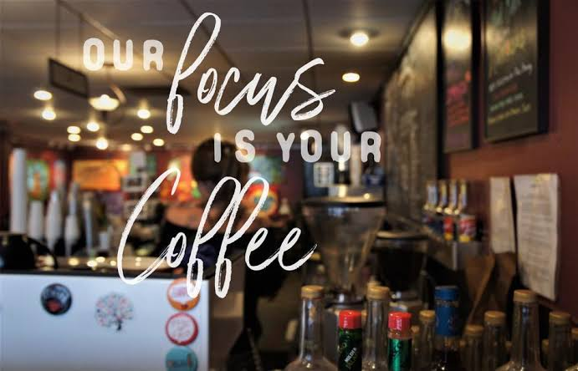
6. Top Selling Products by City
What are the top 3 selling products in each city based on sales volume?

Slide 10
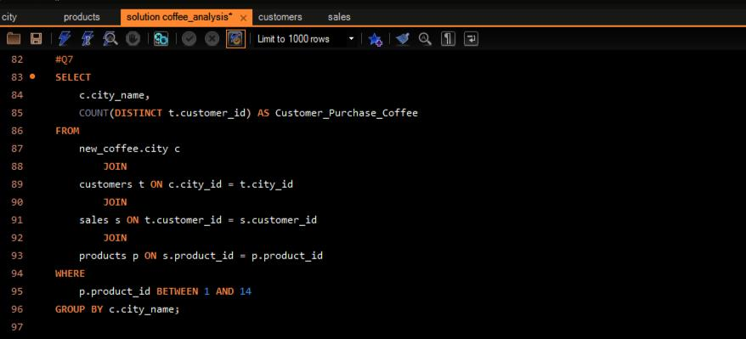
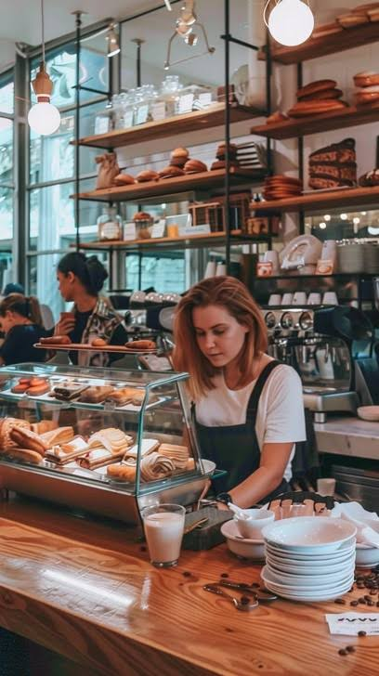
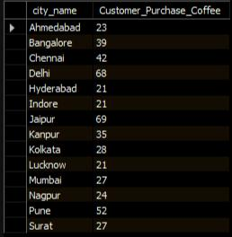
7. Customer Segmentation by City
How many unique customers are there in each city who have purchased coffee products?

Slide 11
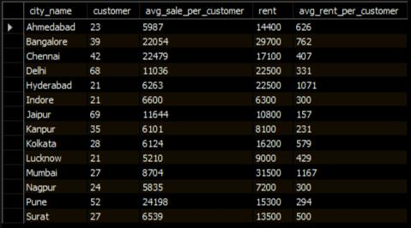
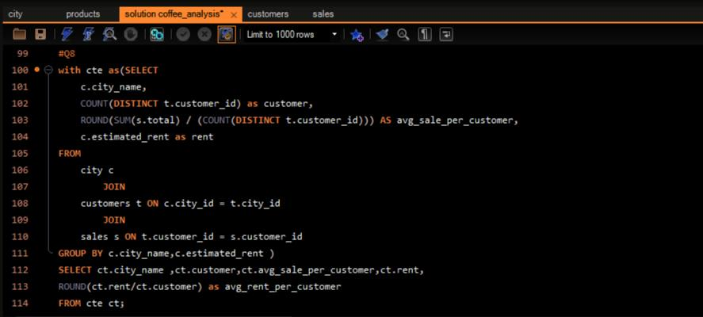

8. Average Sale vs Rent
Find each city and their average sale per customer and avg rent per customer

Slide 12
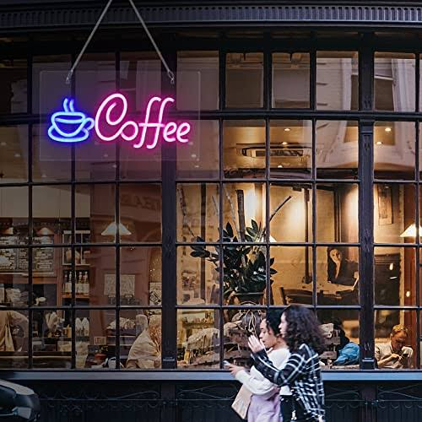

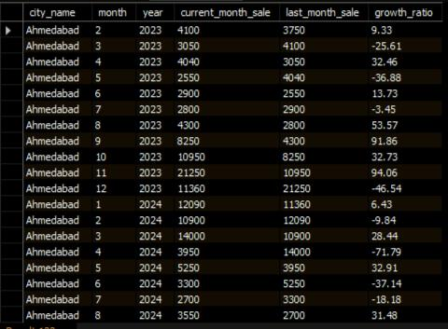
9. Monthly Sales Growth
Sales growth rate: Calculate the percentage growth (or decline) in sales over different time periods (monthly).

Slide 13


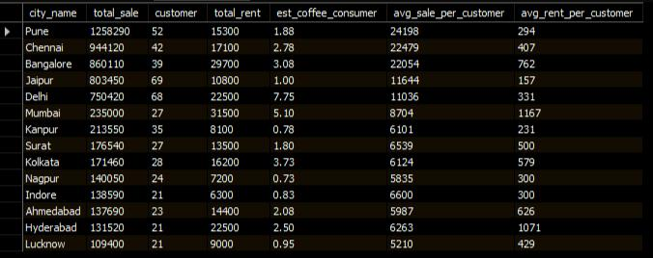
10. Market Potential Analysis
Identify top 3 city based on highest sales, retum city name, total sale, total rent, total customers, estimated coffee consumer

Slide 14



Recommendation
After the Analysis Find the top 3 cities best for next opening
City 1: Pune
City 3: Jaipur
Highest total revenue
Average sale per customer also high
Average rent per customer rent is low
Highest number of customers, which is 69
Average sales per customer is better 11.6k
Average rent per customer is very low at 156
City 2: Delhi
Highest estimated coffee consumers at 7.7 million
Highest total number of customers, which is 68
Average rent per customer is 330 (still under 500)

Slide 15
THANK YOU

